Slide 1
HKN Kappa Upsilon CTS Meeting Presentation
01/21/2017

Slide 2
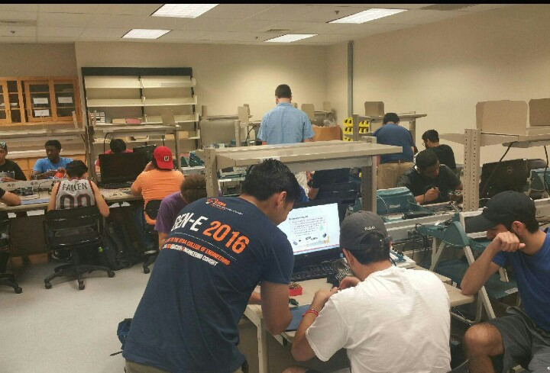
Agenda
HKN Membership
Soldering Workshops
Tutoring
Technical Workshops
Peer Mentorship Program
Course Development
High School Outreach
Speakers

Slide 3
Membership
Membership doubled this past semester
Participation from members has increased from 10 in the previous semester to 27 members this semester (so far)
Applications to join HKN has doubled

Slide 4
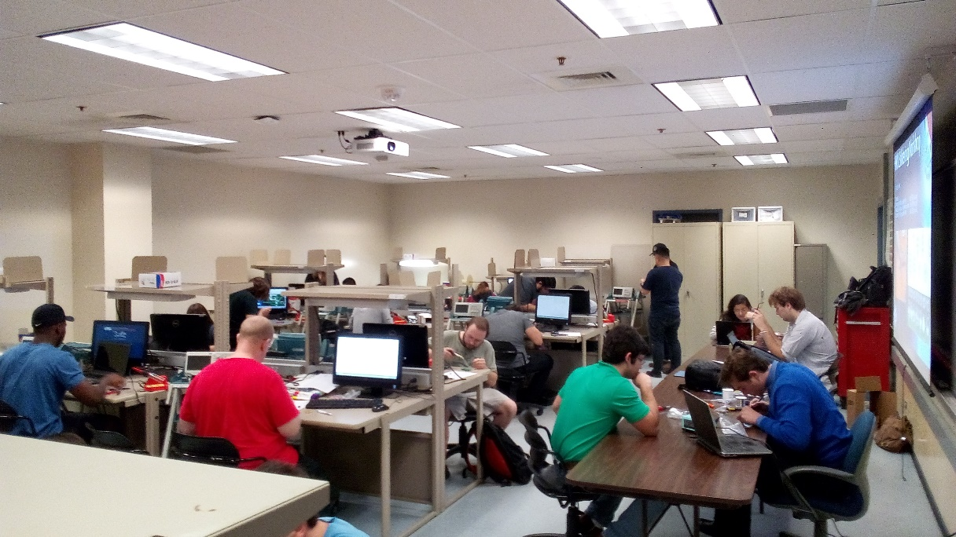
Soldering Workshop
Three Soldering Workshops were held (3 hours each)
16 IEEE-HKN members participated
51 Students Helped ~74% of the class enrolled

Slide 5
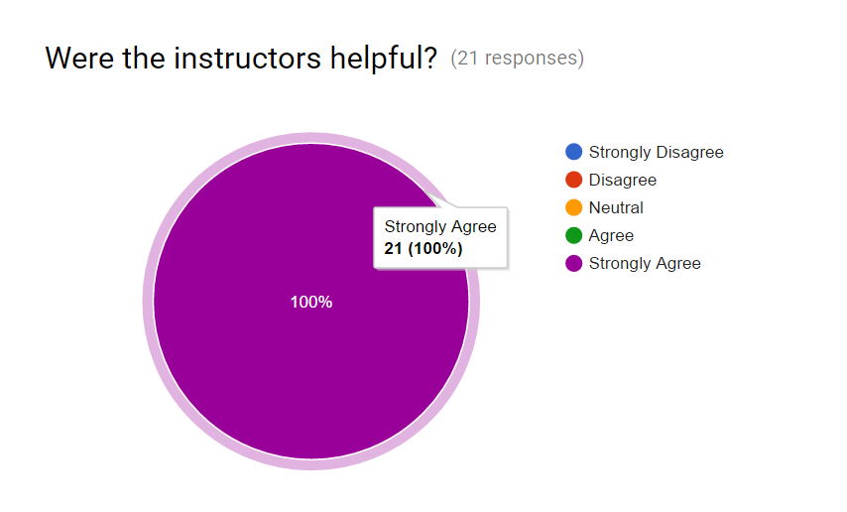
Soldering Workshop
Based on 21 Responses 100% of the students Strongly Agree the workshop and the instructors were helpful

Slide 6
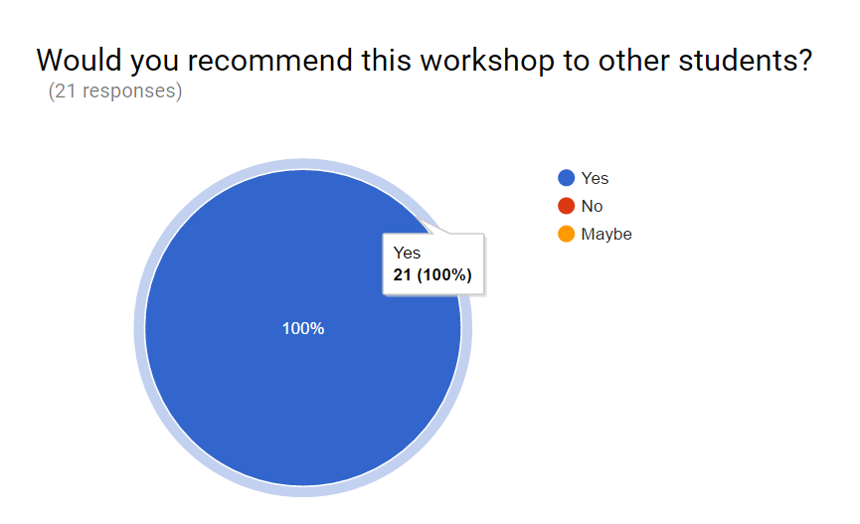
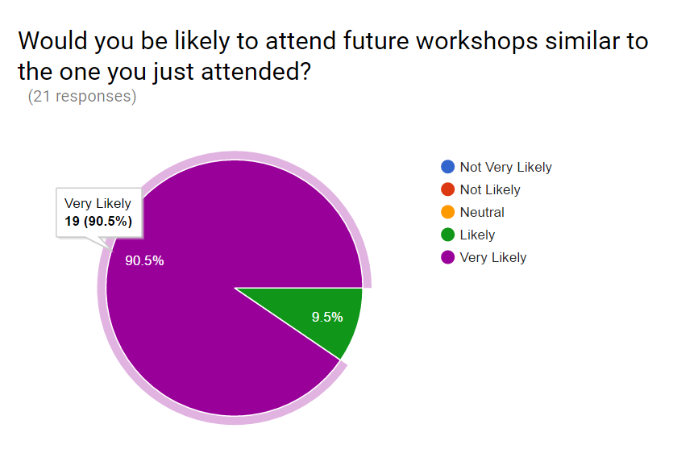
Soldering Workshop
100 % of students would recommend this Workshop
90.5 % are very likely to attend a similar workshop whereas 9.5 are likely to attend

Slide 7
Soldering Workshop
Request of improvement of workshop by students:
More stations, tools and equipment
Advise what parts to solder first
More times for the workshop to be done
More similar workshops

Slide 8
Soldering Workshop
Workshop performance compared to previous semester
Category | Fall 2016 | Spring 2017 | % Increase
# of Stations | 6 | 18 | 200%
Students Helped | 22 | 51 | 131%
Survey Participation | 59% | 41% | -18%
Workshop Helpful | 96.92% | 100% | 3.08%
Instructors Helpful | 98.46% | 100% | 1.54%
Attend Future Workshops | 90.77 % | 100% | 9.23%
Most Common Complaint | Need more irons | Need more tools/more workshops | NA
Workshops Offered | 1 (3hr/each) | 3 (3hr/each) | 200%

Slide 9
Soldering Workshop
GOALS
Maintain quality of workshops
Get the necessary tools/equipment for each station to improve quality of workshop
Develop checkout system of equipment to members of HKN as a benefit to membership
Increase number of soldering workshops available and/or improve outreach to class to increase attendance to events.

Slide 10
Tutoring
Tutoring services will be offered to students ranging from freshmen to senior level courses
Tutoring will be available from 8am-5pm.
As of now from 8am-12pm tutoring will be available every day for most courses thereafter it will be to limited courses.

Slide 11
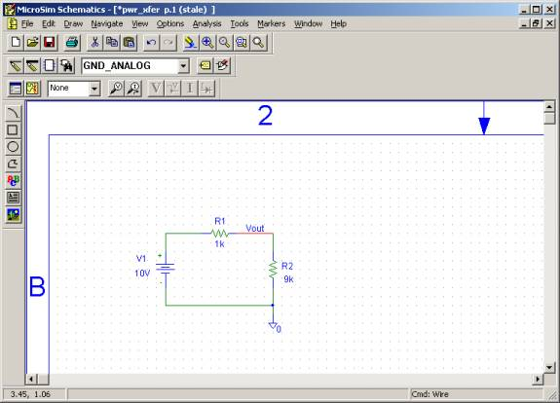
Workshops
HKN hosts technical workshops throughout the semester
Fall 2016 Workshops offered:
MATLAB coder and global optimization tool
Data Compression with Huffman Coding
PSpice Analysis Techniques
Introduction to Simulink

Slide 12
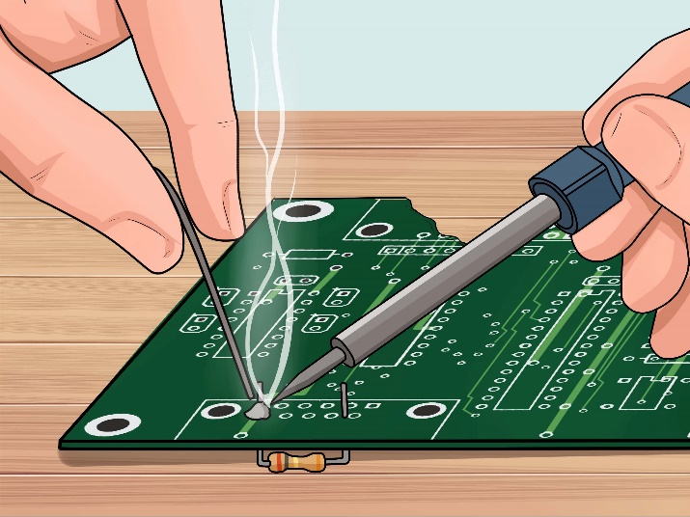
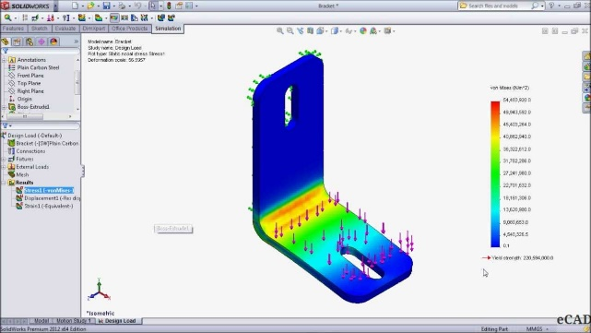
Workshops
Workshops planned for Spring 2017
Data Encryption
Python and MATLAB programming
Solidworks Part Modeling
Solidworks Load Simulation
Circuit soldering workshop

Slide 13
Peer Mentorship Program
One on One Mentoring program is in process of being launched
The Program will include a biweekly workshop related in professional development(e.g. resume building, course planning recommendations, etc.)

Slide 14
Course Development
HKN collaboration with the ECE department to improve mandatory classes for students to improve quality of education.
Some examples are:
Rewriting all the Microcontroller Labs for a course
Creating videos to be posted in BB as an additional learning resource
Implemented changes in software used in class from an unstable educational one to one used in industry while teaching students to use new software

Slide 15
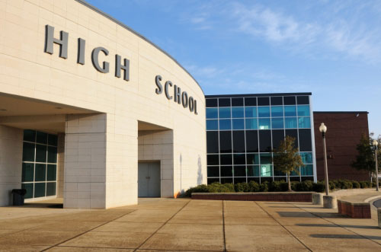
High School Outreach (In progress)
Five high schools nearby from UTSA were asked about their interest in a program to promote the ECE careers by informing the students about the profession.
This is a pilot program that HKN is collaborating with the ECE department at UTSA
OUTREACH

Slide 16
Speakers
Date | Presenter | Affiliation
January 25 2017 | T. Scott Atkinson | IEEE Communications Society
February 22 2017 | Susan Pope | Space Instrumentation at SWRI
March 13 2017 | Karen Pedersen | IEEE WIE
March 22 2017 | Ryan Lamm | Intelligent Systems at SWRI IEEE TEMS
April 26 2017 | Maruthi Akella | IEEE AESS

Slide 17
Conclusions
The HKN KU chapter is proud of what it has accomplished with its limited resources and promoting IEEE-HKN ideals at UTSA.
“To aid and assist whenever the need for something exists that is within our power to give”

Slide 18
Questions?

